Slide 1
Synchronization Producer Consumer Problem Deadlock

Slide 2

Synchronisation Facilities
Classic Synchronization Problems
Modern programming languages do vary slightly in how threads of a process are created, managed and synchronize access to critical sections.
Shared buffer, only need to enforce mutual exclusion with a mutual exclusion signal or semaphore to correctly solve this problem.
Bounded buffer (Producers and consumers) - pipe or finite queue
Readers and Writers: simple lock solution or monitor solution

Slide 3
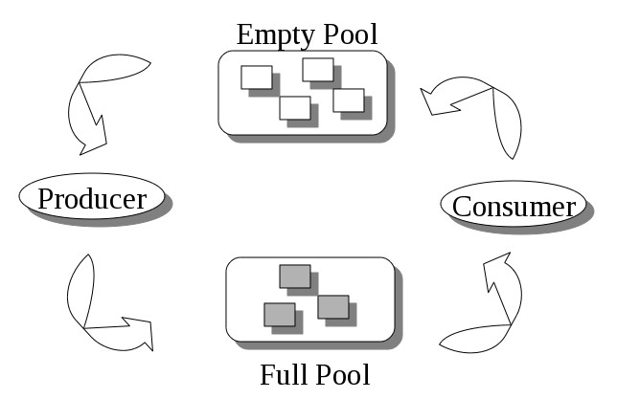
Classic Synchronization Problems
Shared Buffer
A finite supply of containers is available.
Producers take an empty container and fill it with a product.
Consumers take a full container, consume the product and leave an empty container.
The main complexity of this problem is that we must maintain the count for both the number of empty and full containers that are available.

Slide 4
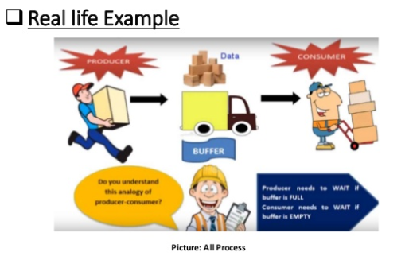
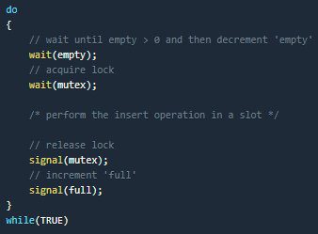
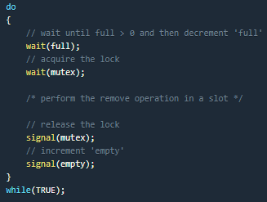
Producer Consumer Problem

Slide 5
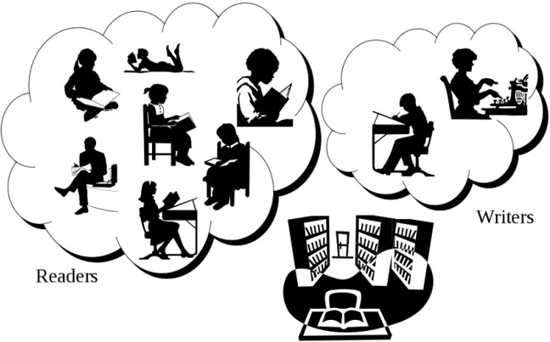
Synchronisation Facilities
Readers and Writers
Readers and Writers: simple lock solution or monitor solution Writers have mutual exclusion, but multiple readers at the same time is allowed.

Slide 6


Deadlock
Deadlock is a situation that occurs in OS when any process enters a waiting state because another waiting process is holding the demanded resource

Slide 7
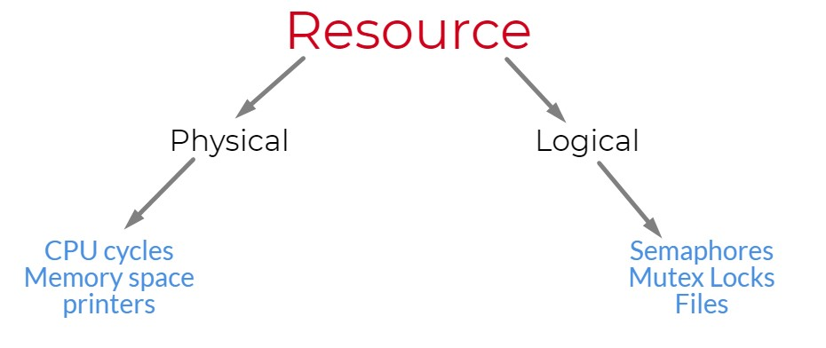

Slide 8
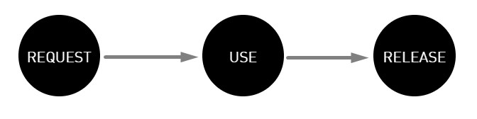
Phases of Resource

Slide 9
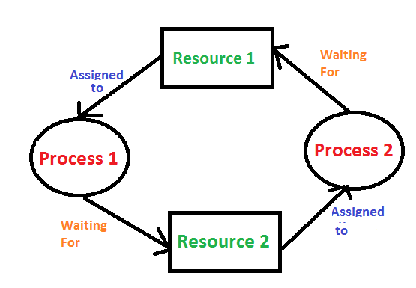
When it will happen
A set of blocked processes each holding a resource and waiting to acquire a resource held by another process in the set.

Slide 10
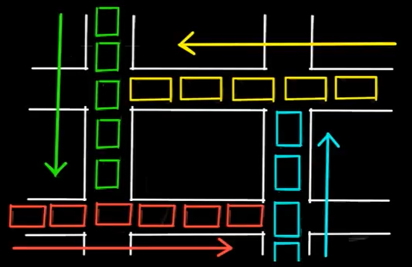
Resource in a computer system can be files, data bases, other processes, I/O & library files, hardware access etc..

Slide 11
Conditions for Deadlock to occur
Deadlock can occur if following four condition hold simultaneously
Mutual
Hold and wait
No preemption
Circular wait

Slide 12
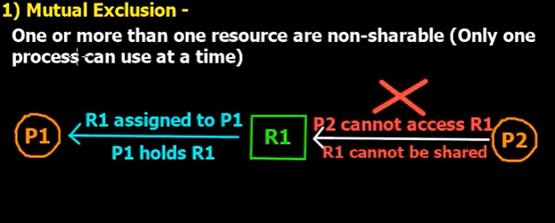
Only one process at a time can use the resource. If another process requests that resource, the requesting process must be delayed until the resource has been released

Slide 13
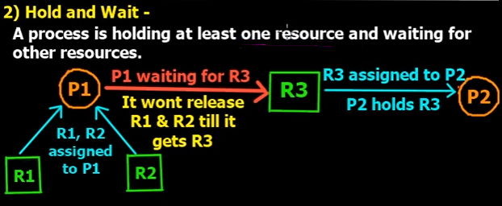
A process must be holding at least one resource and waiting to acquire additional resources that are currently being held by other processes.

Slide 14
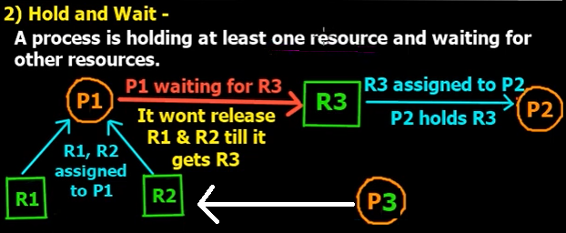

Slide 15
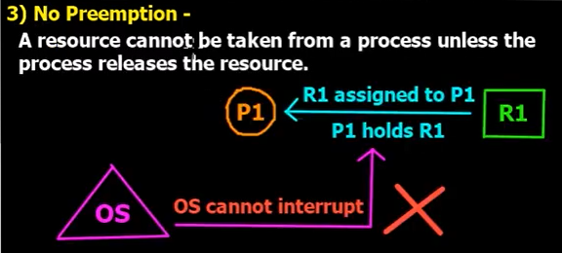
Resources cannot be preempted; that is, a resource can be released only voluntarily by the process holding it, after that process has completed its task.

Slide 16
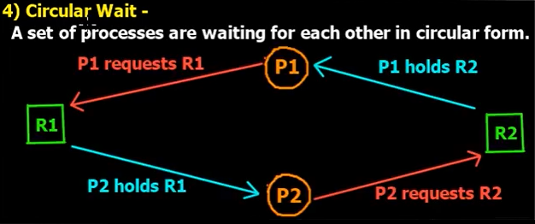
A process is waiting for the resource held by the second process, which is waiting for the resource held by the third process and so on, till the last process is waiting for a resource held by the first process. This forms a circular chain

Slide 17
Methods for Handling deadlock
Deadlock prevention or avoidance
Not to let the system into deadlock state
Deadlock deduction and recovery
Do preemption to handle it once occurred
Ignore the problem all together
If deadlock is very rare, then reboot

Slide 18
Strategies to handle deadlock
Preemption
We can take a resource from once process and give it other process, but will cause problems.
Rollback
The system can periodically make a record of the state of all the process, when deadlock occurs roll everything back to the last checkpoint.
Kill one or more processes.
Simplest way, but it will work

Slide 19
Resource Allocation Graph
Deadlock can easily be represented by a direct graph Resource Allocation Graph (RAG)
Directed Graph.
A set of vertices V and a set of edges E.
V is partitioned into two types:
P = {P₁, P₂, …, P_{n}}, the set consisting of all the processes in the system.
R = {R₁, R₂, …, R_{m}}, the set consisting of all resource types in the system.
request edge – directed edge P₁ → R_{j}
assignment edge – directed edge R_{j} → P_{i}

Slide 20
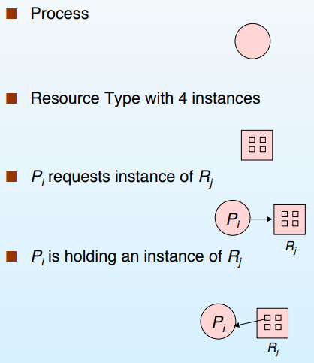
RAG – Representation

Slide 21
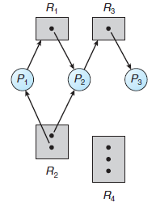
The sets P, R, and E
P = {P1, P2, P3}
R = {R1, R2, R3, R4}
E = {P1 → R1, P2 → R3, R1 → P2,
R2 → P2, R2 → P1, R3 → P3}
Resource instances:
◦ One instance of resource type R1
◦ Two instances of resource type R2
◦ One instance of resource type R3
◦ Three instances of resource type R4
Resource Allocation Graph

Slide 22
Process States
Process P1 is holding an instance of resource type R2 and is waiting for an instance of resource type R1.
Process P2 is holding an instance of R1 and an instance of R2 and is waiting for an instance of R3.
Process P3 is holding an instance of R3.
Resource Allocation Graph

Slide 23
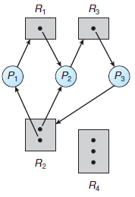

Resource Allocation Graph

Slide 24
DEADLOCK AVOIDANCE
A system has R identical resources, P processes competing for them and N is the maximum need of each process.
The task is to find the minimum number of Resources required So that deadlock will never occur.
R >= P * (N - 1) + 1

Slide 25
CALCULATION
Consider, 3 process A, B and C. let, Need of each process is 4
Therefore, The maximum resources require will be 3 * 4 = 12
Give 4 resources to each Process and The minimum resources required will be
3 * (4 – 1) + 1 = 10.
Give 3 Resources to each of the Process, and we are left out with 1 Resource.
That 1 resource will be given to any of the Process A, B or C.
So that after using that resource by any one of the Process, It left the resources and that resources will be used by any other Process and thus Deadlock will Never Occur.

Slide 26
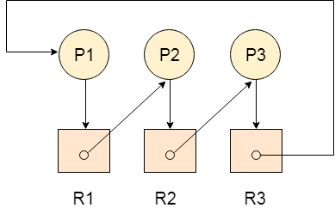
DEADLOCK DETECTION
It contains three processes P1, P2, P3 and
three resources R2, R2, R3

Slide 27
DEADLOCK DETECTION
Allocation Matrix
Process R1 R2 R3
P1 0 0 1
P2 1 0 0
P3 0 1 0
Request Matrix
Process R1 R2 R3
P1 1 0 0
P2 0 1 0
P3 0 0 1
Avail = (0,0,0)

Slide 28
DEADLOCK DETECTION
R1
P2
P1
P2
P3
P1
P3
R2
P4
R3
P4
Resource Allocation Graph
Wait For Graph

Slide 29
DEADLOCK DETECTION
R1
R4
P2
P1
P2
P3
P1
P3
R2
P4
R3
P4
Resource Allocation Graph
Wait For Graph

Slide 30
Thank you

